Slide 1

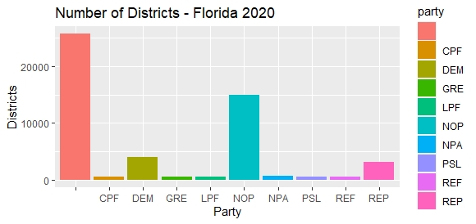
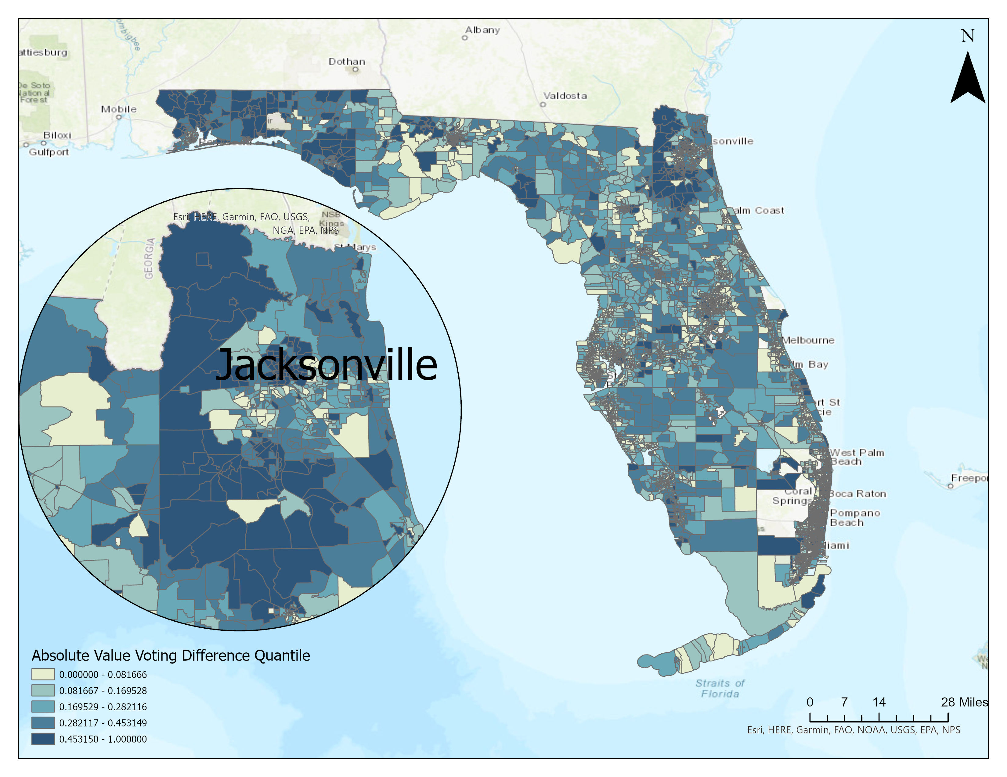

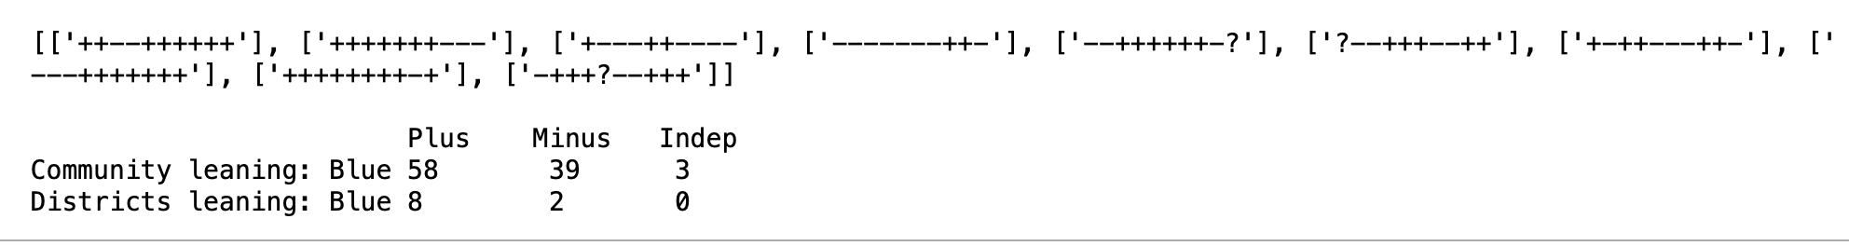

Sesame Street Neighbor’s Tasks
1 2 3
Visualization 2

Slide 2


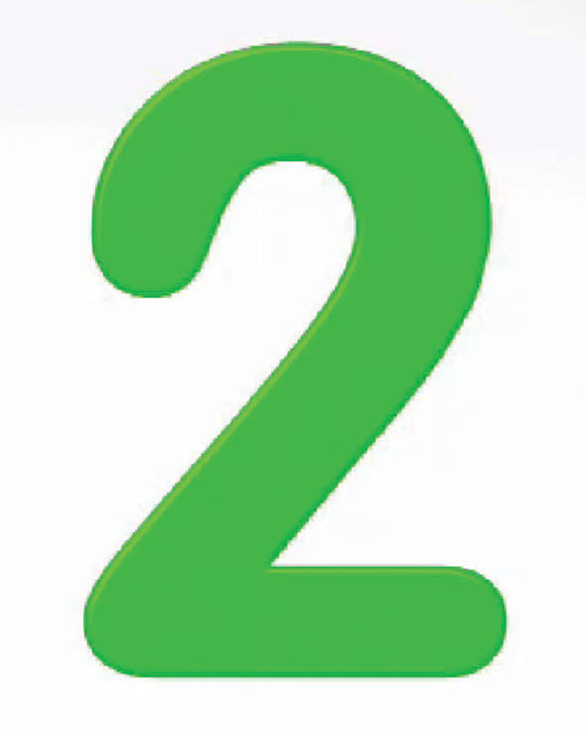
Sesame Street Neighbor’s Tasks
1 2 3
Goal: An evaluation tool to assess for fair voter districting
1. Developing voter simulation code – converting 1D to 2D
2. Structuring our data sets – format conversions/analysis
3. Alt. districting solution planning in progress – apply to #1 and #2

